Slide 1
Index structures/files
Secondary Index
Multi-Level Index
B⁺- Tree
Notes:
1

Slide 2
Types of Single-Level Indexes
Secondary Index
A secondary index provides a secondary means of accessing a file for which some primary access already exists.
The secondary index may be on a field which is a candidate key and has a unique value in every record, or a nonkey with duplicate values.
The index is an ordered file with two fields.
The first field is of the same data type as some nonordering field of the data file that is an indexing field.
The second field is either a block pointer or a record pointer. There can be many secondary indexes (and hence, indexing fields) for the same file.
Includes one entry for each record in the data file; hence, it is a dense index

Slide 3
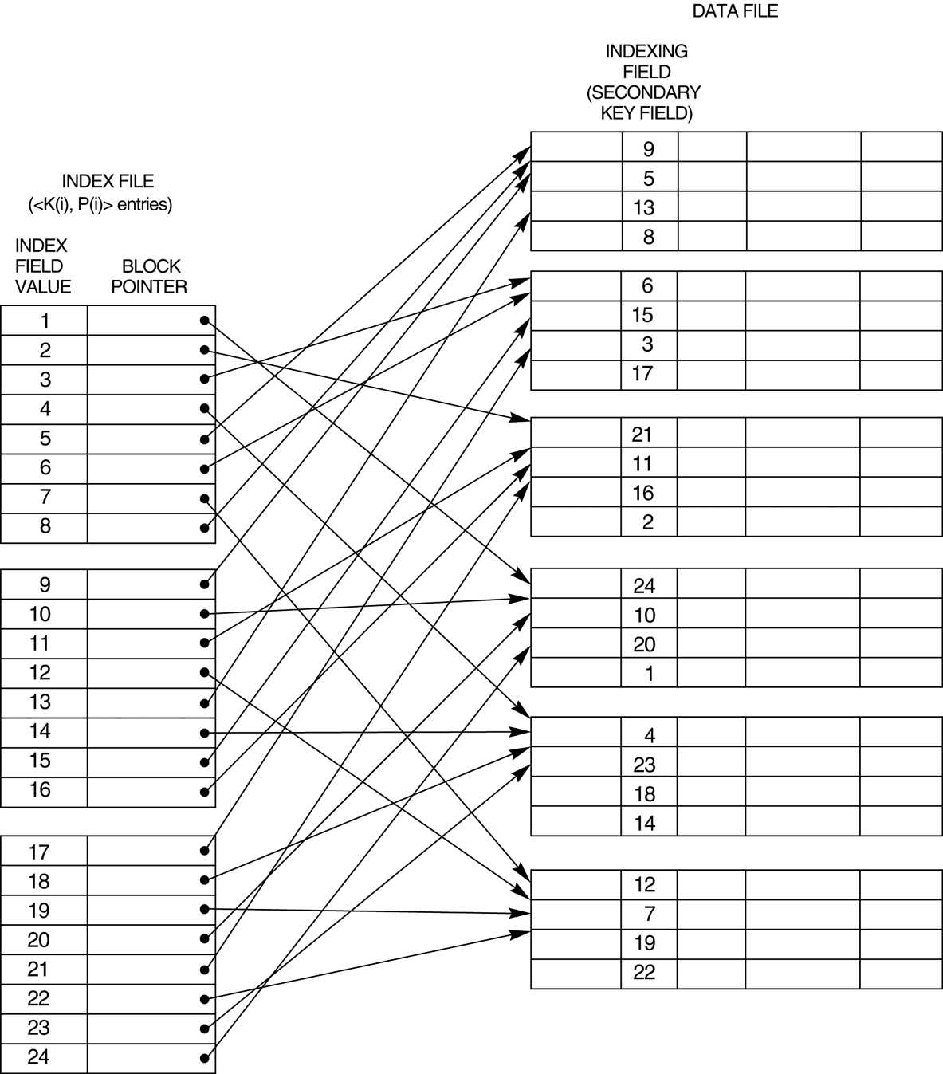
A dense secondary index (with block pointers) on a nonordering key field of a file.

Slide 4
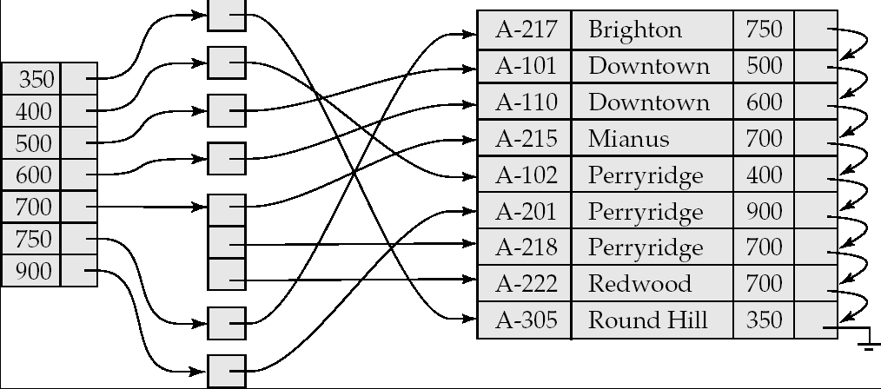
Secondary Indices Example
Secondary index on balance field of account
Index record points to a bucket that contains pointers to all the actual records with that particular search-key value.

Slide 5
Secondary indexes
SELECT name, address
FROM MovieStar
WHERE birthdate= ‘1952-01-01’
CREATE INDEX BDIndex ON MovieStar(birthdate);
Secondary indexes are always ‘dense’
Second level index could be ‘sparse’
Secondary indexes are usually with duplicates

Slide 6
20
40
Secondary index
10
10
20
20
10
20
50
30
20
30
40
50
10
50
60
20

Slide 7
Pointers in one index block may refer to multiple data blocks
Results in more number of Disk I/Os
Unavoidable problem
Using ‘bucket file’ between index file and data file
Single entry <k,p> for each value ‘k’ where p points to location in bucket file containing all other pointers of records with value ‘k’
Avoids wastage of space due to multiple storage of same value ‘k’

Slide 8
Definition of Bucket
Bucket - another form of a storage unit that can store one or more records of information.
Buckets are used if the search key value cannot form a candidate key, or if the file is not stored in search key order.

Slide 9
20
40
10
20
30
40
10
20
50
30
50
60
10
50
60
20
Index file
Bucket file
Data file

Slide 10
Application of ‘bucket file’
It can help answer queries efficiently using intersection of pointer sets
Example
SELECT title
FROM Movie
WHERE StudioName=‘Disney’ AND year=1995;
This reduces number of Disk I/Os

Slide 11
Movie Tuples
Buckets for studio
Buckets for year
Disney
1995
Studio index
Year index

Slide 12
Multi-level indexes
When an index is too large with even binary search taking too many disk I/Os
Define second level index: index on index
This can continue to multi-level index structure
Second and higher level indexes must be sparse
Second level index in previous example would take only 10 blocks, 40KB
Search involves 2 disk I/Os and searching in the block

Slide 13
Multilevel Index
If an index does not fit in memory, access becomes expensive.
To reduce number of disk accesses to index records, treat the index kept on disk as a sequential file and construct a sparse index on it.
outer index – a sparse index on main index
inner index – the main index file
If even outer index is too large to fit in main memory, yet another level of index can be created, and so on.
Indices at all levels must be updated on insertion or deletion from the file.

Slide 14
Multilevel Index (Cont.)
outer index
inner index
Data
Block 0
Index
Block 0


Data
Block 1

Index
Block 1





Slide 15
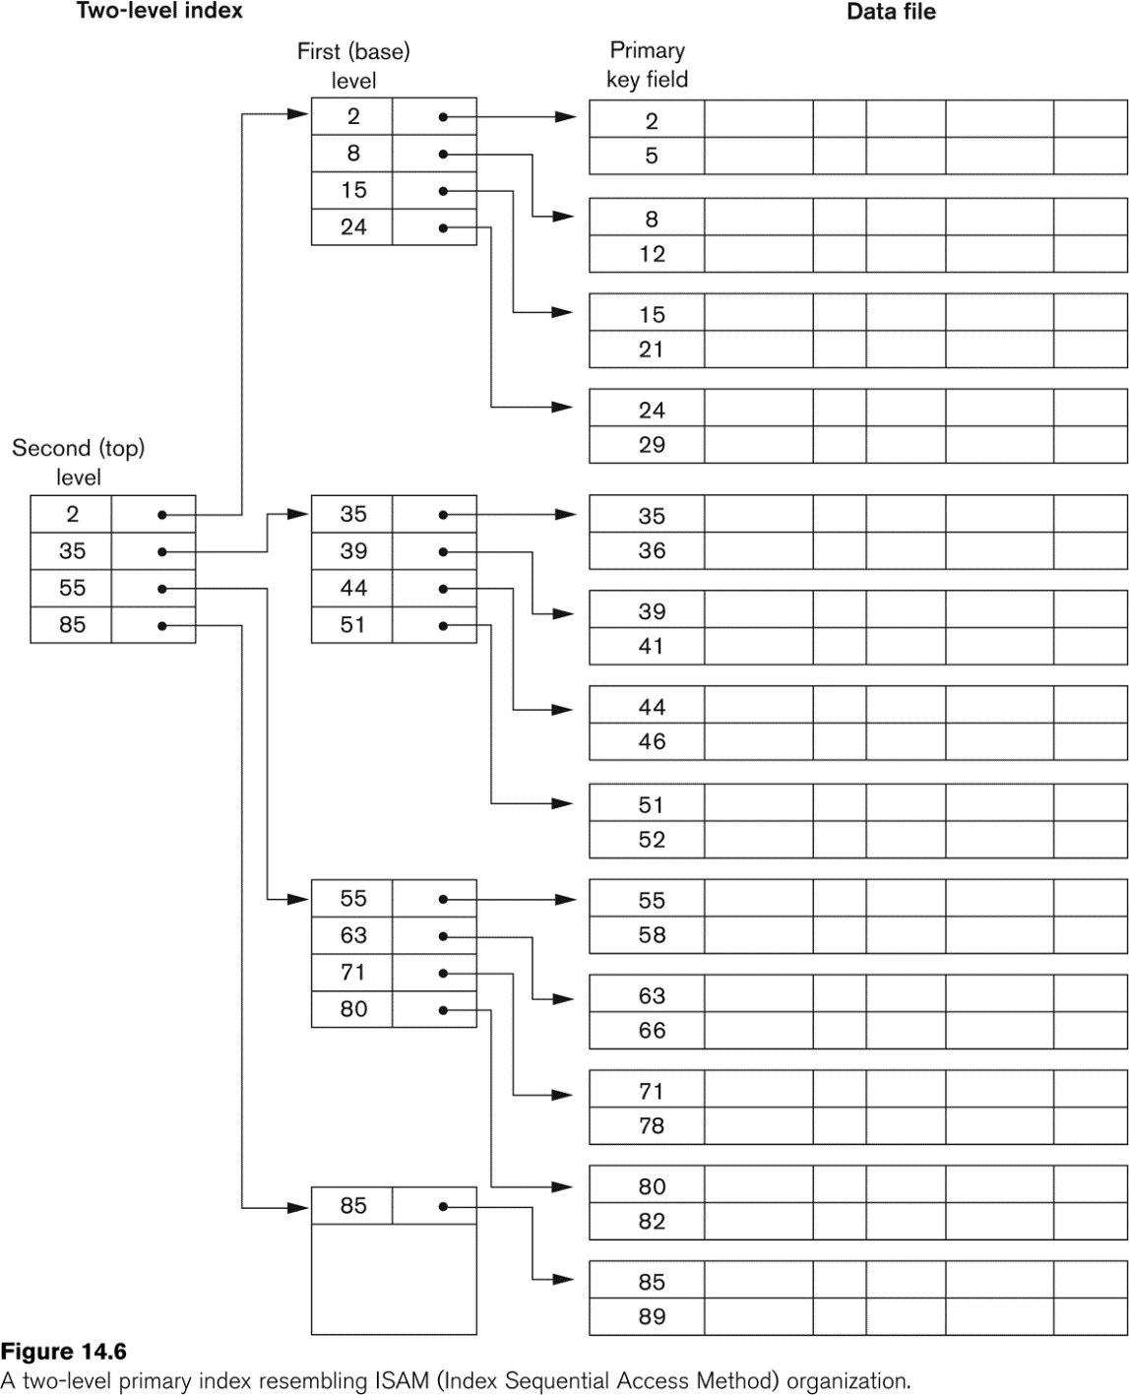
A Two-level Primary Index

Slide 16
Estimating Costs
For simplicity we estimate the cost of an operation by counting the number of blocks that are read or written to disk.
We ignore the possibility of blocked access which could significantly lower the cost of I/O.
We assume that each relation is stored in a separate file with B blocks and R records per block.

Slide 17
Choosing Indexing Technique
Five Factors involved when choosing the indexing technique:
access type
access time
insertion time
deletion time
space overhead

Slide 18
Indexing Definitions
Access type is the type of access being used.
Access time - time required to locate the data.
Insertion time - time required to insert the new data.
Deletion time - time required to delete the data.
Space overhead - the additional space occupied by the added data structure.

Slide 19
Index Evaluation Metrics
Access time for:
Equality searches – records with a specified value in an attribute
Range searches – records with an attribute value falling within a specified range.
Insertion time
Deletion time
Space overhead

Slide 20
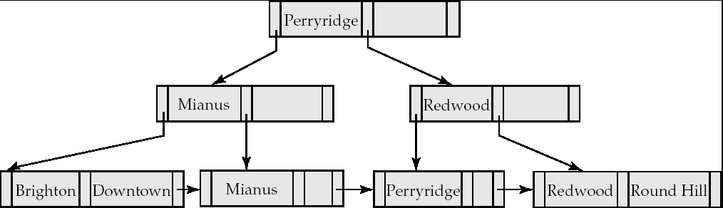
B⁺-Tree Index
A B⁺-tree is a rooted tree satisfying the following properties:
All paths from root to leaf are of the same length
Each node that is not a root or a leaf has between ⎡n/2⎤ and n children. [Non leaf node]
A leaf node has between ⎡(n–1)/2⎤ and n–1 values
Special cases:
If the root is not a leaf, it has at least 2 children.
If the root is a leaf (that is, there are no other nodes in the tree), it can have between 0 and (n–1) values.

Slide 21
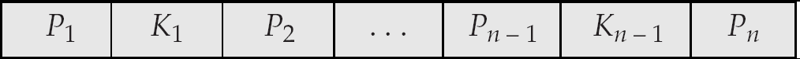
B⁺-Tree Node Structure
Typical node
K_{i} are the search-key values
P_{i} are pointers to children (for non-leaf nodes) or pointers to records or buckets of records (for leaf nodes).
The search-keys in a node are ordered
K₁ < K₂ < K₃ < . . . < K_{n–1}

Slide 22
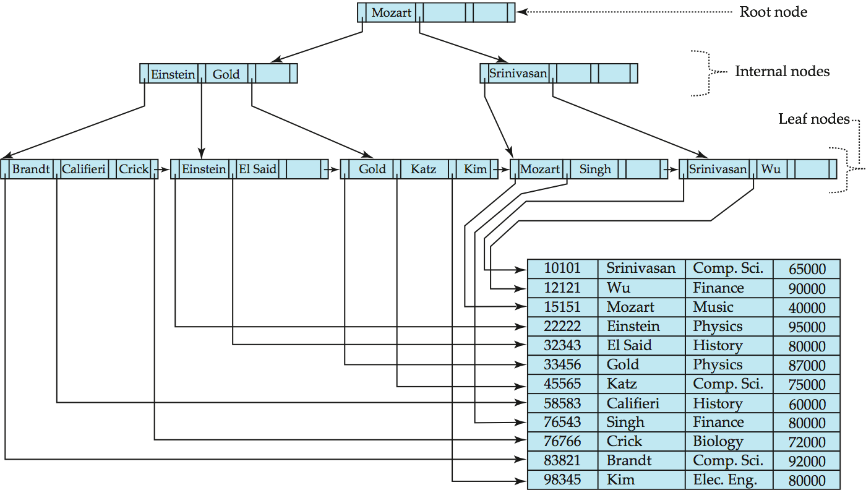
Example of B⁺-Tree

